Slide 1
OSPF
Open Shortest Path First (OSPF) is also an intradomain routing protocol
it is based on the link-state routing protocol

Slide 2
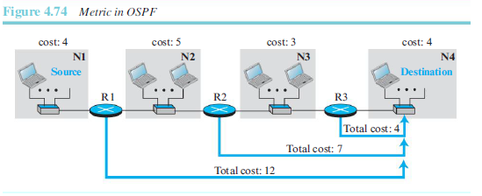
Metric
Cost of reaching a destination from the host is calculated from the source router to the destination network.
Each link (network) can be assigned a weight based on the throughput, round-trip time, reliability

Slide 3
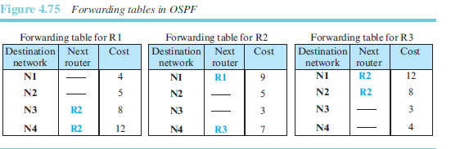
Forwarding Tables

Slide 4
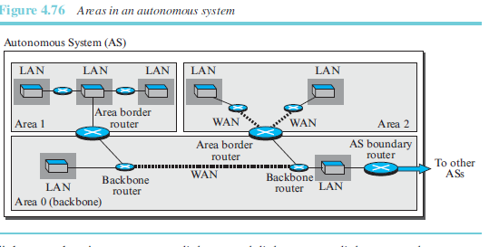
Link-State Advertisement

Slide 5
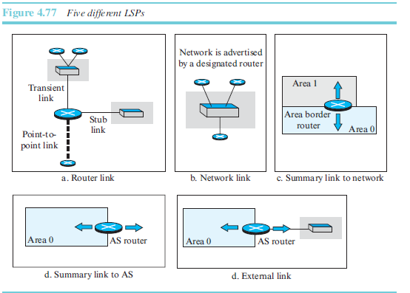
Five types of link-state advertisements:
router link,
network link,
summary link to network
summary link to AS border router
external link.

Slide 6
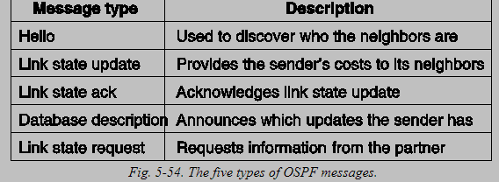
OSPF Messages

Slide 7
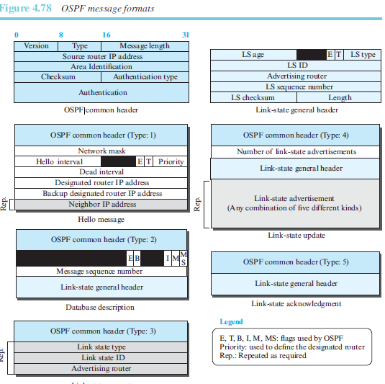

Slide 8
OSPF Algorithm
OSPF implements the link-state routing algorithm we discussed in
the previous section. However, some changes and augmentations need to be added to the algorithm:
After each router has created the shortest-path tree, the algorithm needs to use it to create the corresponding routing algorithm.
The algorithm needs to be augmented to handle sending and receiving all five types of messages.

